Slide 1


Conference
Presentation
Presenter Name
Date

Slide 2

Introduction
Pet Companion is a smart pet management system designed to help users manage pet care effectively.
It simplifies pet monitoring through a dashboard, health tracking, and AI assistance.
The aim is to modernize traditional pet care using technology.

Slide 3
Literature Survey
a. Mobile Pet Care Apps (e.g., Pet Desk, 11Pets)
These apps offer vaccination tracking, grooming reminders, and vet appointments.
However, many users find them heavy with unnecessary features or require subscription payments.
b. Veterinary Clinic Management Systems
These systems focus more on clinic-side features like inventory, doctor scheduling, or billing.
They are not suitable for personal use by pet owners.
c. Personal Digital Notes
Some pet owners use note apps or reminders on mobile.
These lack structured data, images, automated categorization, and are difficult to maintain long term.
d. Web-based Pet Portals
Limited availability exists for basic portals, but most lack customization, simplicity, and modern UI/UX.

Slide 4
Requirements
Software Requirements:
• VS Code, Chrome Browser, Windows, MacOS
Languages used:
• HTML, CSS, JavaScript
Hardware Requirements:
• Laptop/PC with Internet
• Minimum 4GB RAM
• Minimum 512 GB Storage
• Any GUI Supports

Slide 5
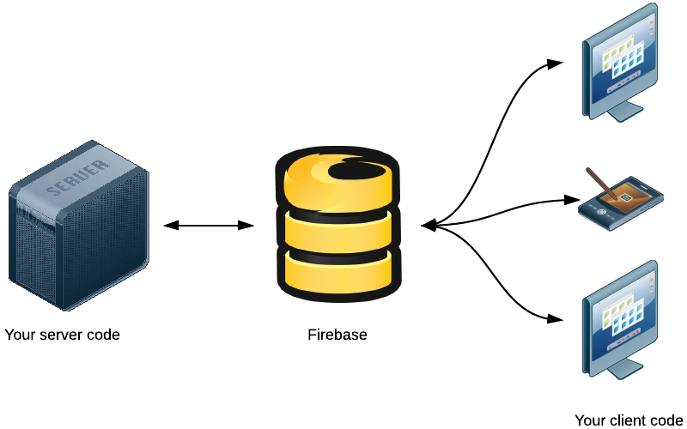
System Design
Client-Side:
HTML, CSS, JavaScript act as the interface.
Backend:
Firebase Authentication & Firestore Database.

Slide 6
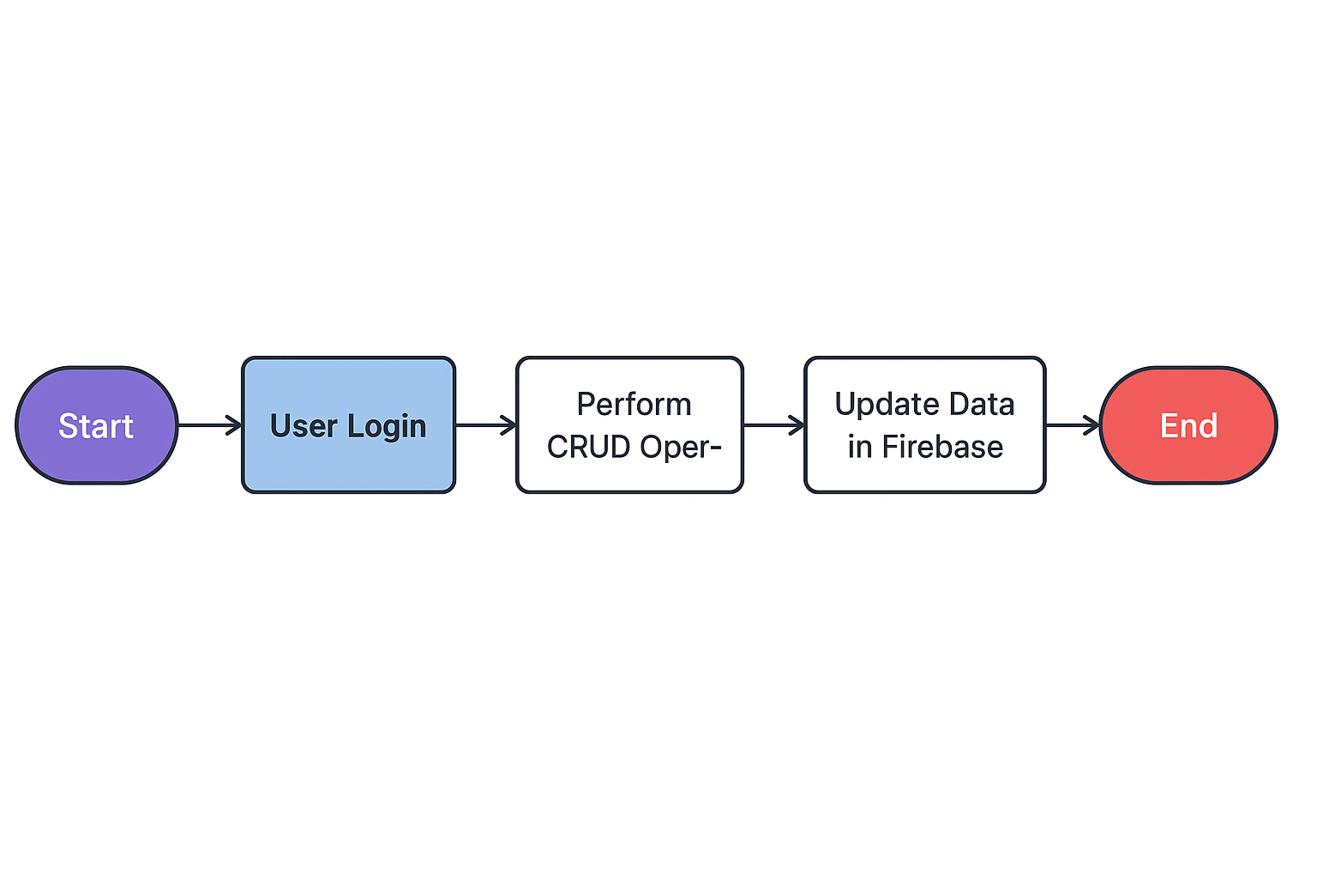
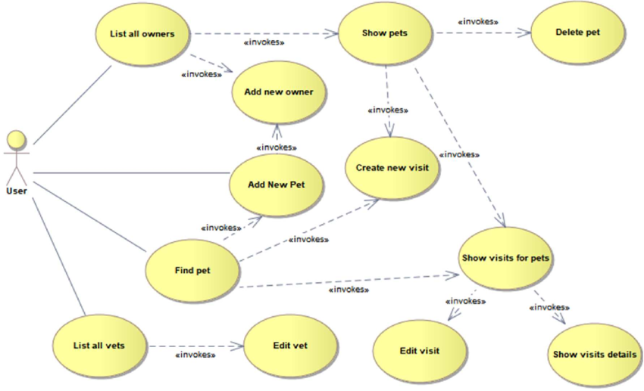
Flowchart
Login → Add Pet → View Pet → Update Pet
→ Delete Pet → Update Profile

Slide 7
Implementation
Module-1
Login System using
Firebase Authentication
Module-2
Module-4
Pet Selection & Registration
Interactive Features
Module-5
Integrated AI Assistant
Module-3
Dashboard Interface

Slide 8
Module-1: Login System using Firebase Authentication
Provides error handling (invalid credentials, missing fields, weak password).
Automatically redirects logged-in users to the dashboard.
Implements secure user login & signup using Firebase Authentication
Firebase handles token generation, session management, and identity verification.
Prevents unauthorized access to pet data and user dashboard.
Provides error handling (invalid credentials, missing fields, weak password).
Automatically redirects logged-in users to the dashboard.

Slide 9
Module-2: Pet Selection & Registration
Store pet data in Firebase Firestore for real-time access.
Supports “Multiple Pet Profiles” — users can maintain more than one pet.
Includes edit and delete functionality to modify or remove pet records.
Pet profiles load dynamically for each logged-in user.
Allows users to add new pets with details like name, age, breed, gender.

Slide 10
Module-3: Dashboard Interface
Central hub where users can view all their registered pets.
Displays pet summary cards with essential details and images. Smooth navigation to specific modules like food guide, grooming, or behavior tracking.
Designed with a clean, modern UI for easy interaction.
Fetches all user data dynamically from Firebase on load.
Responsive layout for desktop and mobile screens.

Slide 11
Module-4: Interactive Features
Food Guide:
Shows recommended foods based on age/breed.
Helps avoid harmful foods
.Grooming Guide:
Suggests grooming routines, bathing frequency, coat care, etc.
Behaviour Notes:
Allows users to store personal notes about pet habits, behaviour changes, aggression, or progress.
Helps track daily patterns and behavioural improvements. Enhances user engagement beyond basic pet registration.

Slide 12
Module-5: Integrated AI Assistant
Acts as a virtual helper for pet owners.
Can answer questions about pet care, diet, behaviour, health, and common problems.
Provides instant guidance based on user input.
Enhances the app’s functionality with smart assistance.
Makes the system more interactive, modern, and user-friendly.

Slide 13
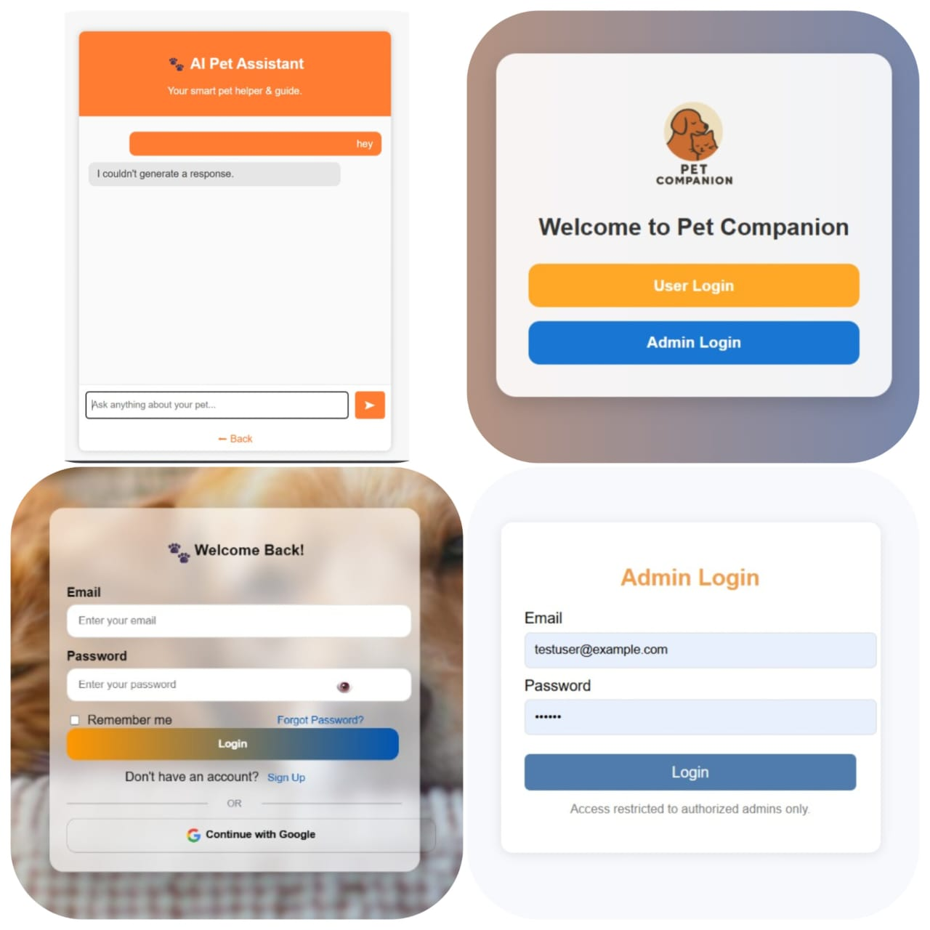
Snapshots

Slide 14
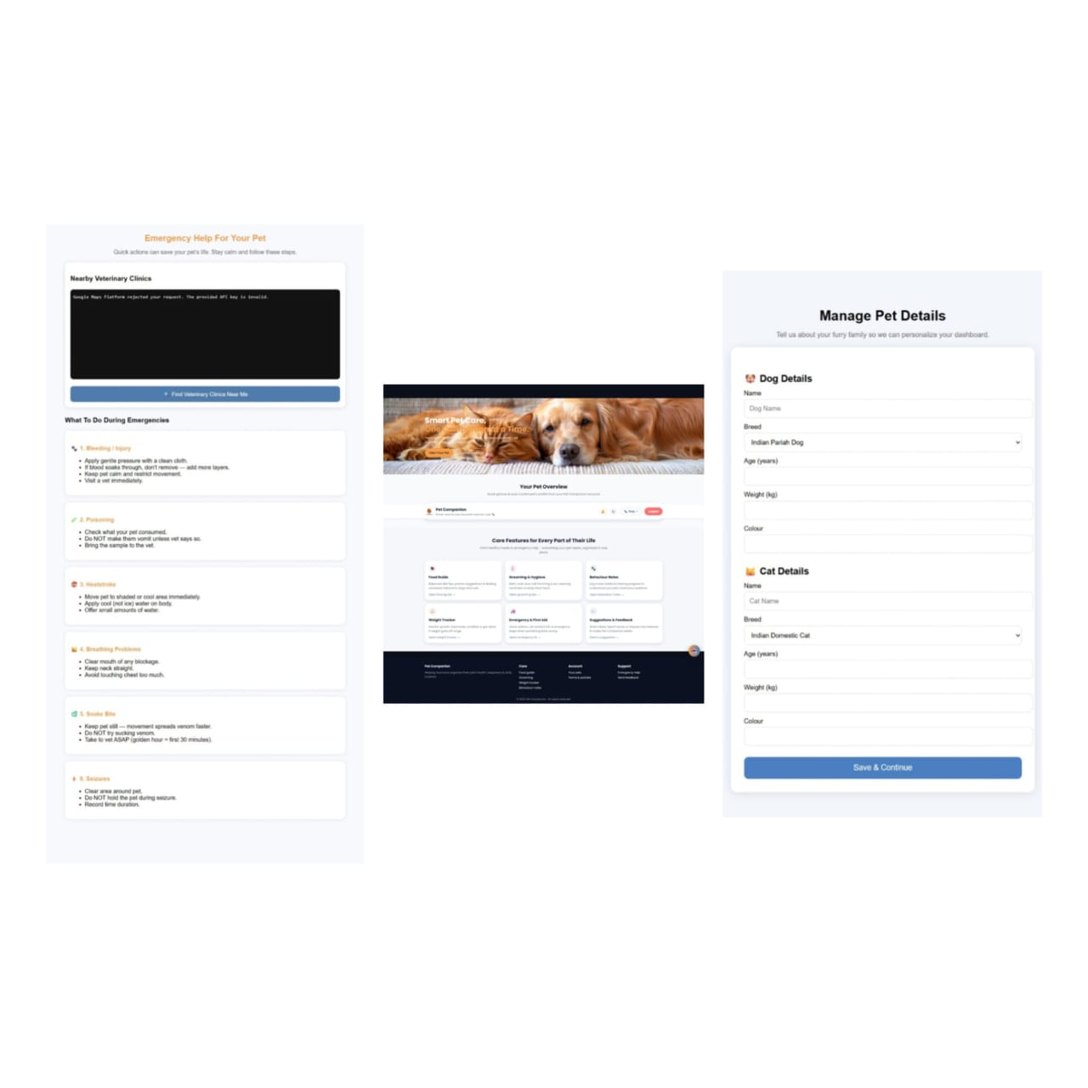
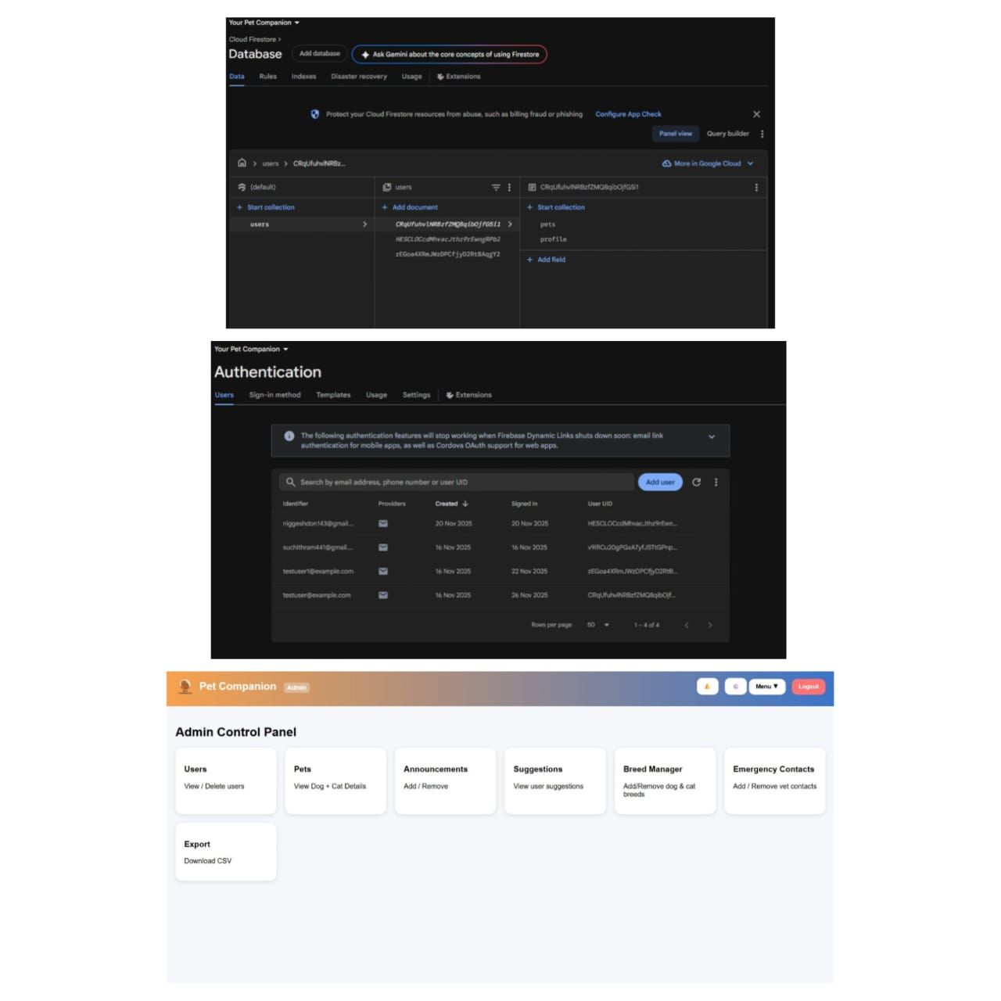

Slide 15
Conclusion:
The Your Pet Companion project successfully demonstrates how modern web technologies can be used to build a practical, user-oriented application. The system provides a structured way for pet owners to organize and manage their pet details—from basic information to images and profile updates.
Key achievements include:
Clean and intuitive user interface
Secure authentication
Efficient use of Firebase for real-time data handling
Easy pet & user profile management
This system can be extended in the future with features like reminders, medical history tracking, notifications, AI-based pet health suggestions, and integration with veterinary services.

Slide 16
REFERENCE
Firebase Documentation. Available at: https://firebase.google.com/docs
MDN Web Docs (Mozilla Developer Network). Available at: https://developer.mozilla.org/
W3Schools – Web Development Tutorials. Available at: https://www.w3schools.com/
Google Material Icons. Available at: https://fonts.google.com/icons
Firebase Authentication API Reference. Available at: https://firebase.google.com/docs/auth
Firebase Fire store Reference. Available at: https://firebase.google.com/docs/firestore
Firebase Web Setup Guide. Available at: https://firebase.google.com/docs/web/setup

